Slide 1
DMA025A
Mathematics-II
Department of Mathematics
JECRC University Jaipur

Slide 2
Unit-I
Matrix

Slide 3
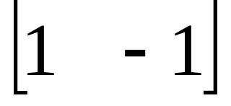
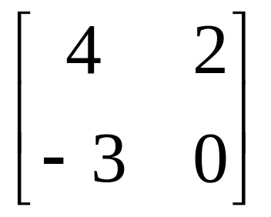
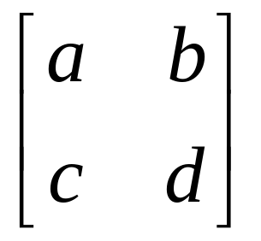
Matrices - Introduction
Definition:
A matrix is a set or group of numbers arranged in a square or rectangular array enclosed by two brackets
Example:1
Example:2
Example:3

Slide 4
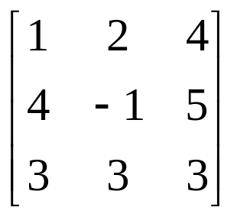
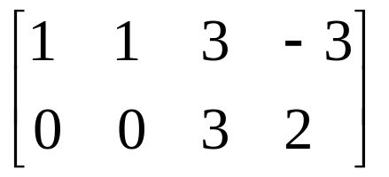
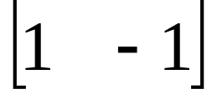
Matrices - Introduction
Properties:
A specified number of rows and a specified number of columns
Two numbers (rows x columns) describe the dimensions or size of the matrix.
Examples: 3x3 matrix, 2x4 matrix and 1x2 matrix

Slide 5
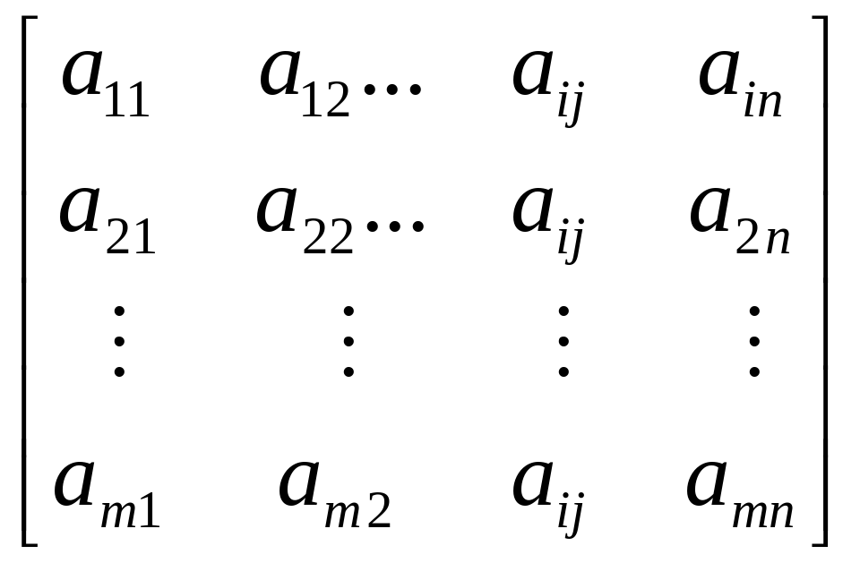
Matrices - Introduction
A matrix is denoted by a bold capital letter and the elements within the matrix are denoted by lower case letters
e.g. matrix [A] with elements a_{ij}
A_{mxn}=
_{m}A^{n}
i goes from 1 to m
j goes from 1 to n

Slide 6
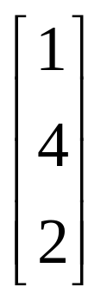
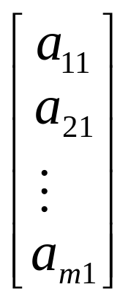
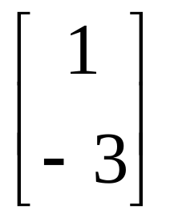
Matrices - Introduction
TYPES OF MATRICES
Column matrix or vector:
The number of rows may be any integer but the number of columns is always 1

Slide 7
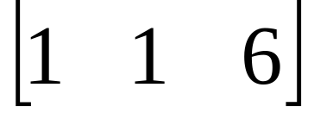
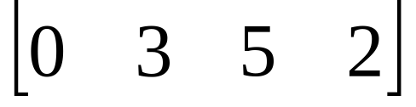
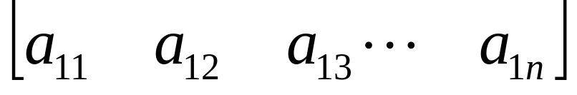
Matrices - Introduction
2. Row matrix or vector
Any number of columns but only one row

Slide 8
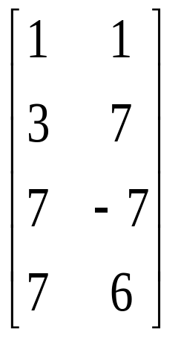
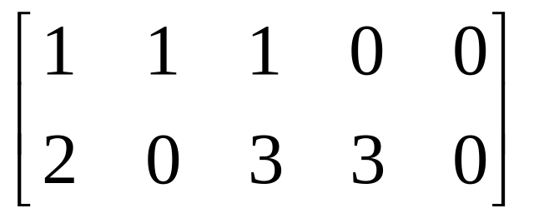

Matrices - Introduction
3. Rectangular matrix
Contains more than one element and number of rows is not equal to the number of columns

Slide 9
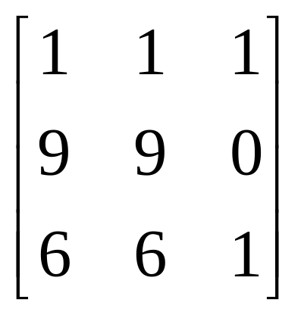
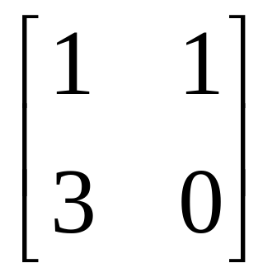
Matrices - Introduction
4. Square matrix
The number of rows is equal to the number of columns
(a square matrix A has an order of m)
m x m
The principal or main diagonal of a square matrix is composed of all elements a_{ij} for which i=j

Slide 10
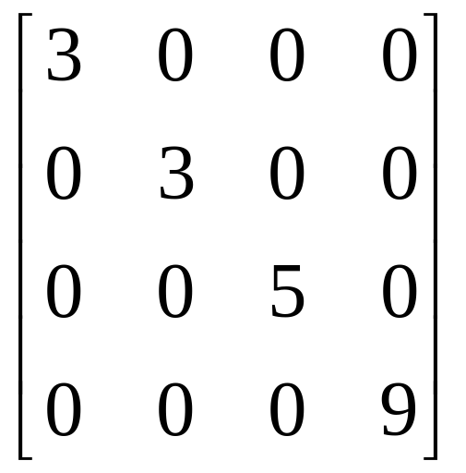
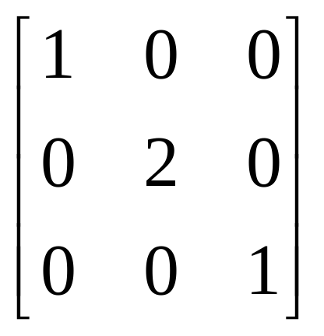
Matrices - Introduction
5. Diagonal matrix
A square matrix where all the elements are zero except those on the main diagonal
i.e. a_{ij} =0 for all i = j
a_{ij} = 0 for some or all i = j

Slide 11
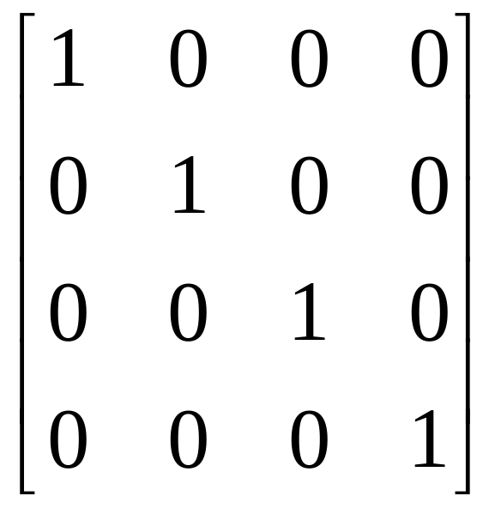
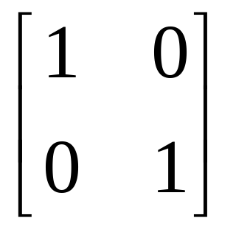
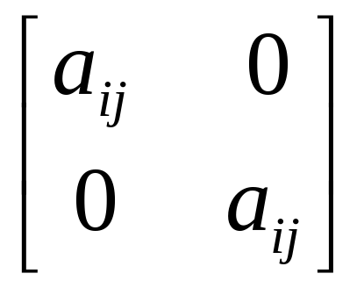
Matrices - Introduction
6. Unit or Identity matrix - I
A diagonal matrix with ones on the main diagonal
i.e. a_{ij} =0 for all i = j
a_{ij} = 1 for some or all i = j

Slide 12
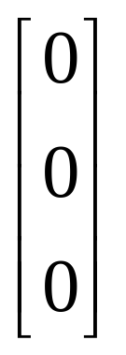
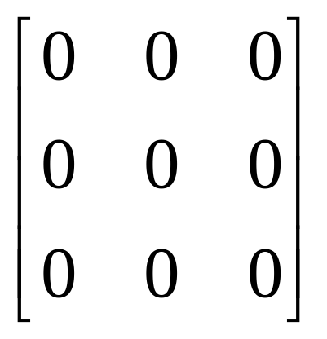
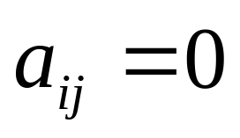
Matrices - Introduction
7. Null (zero) matrix - 0
All elements in the matrix are zero
For all i,j

Slide 13
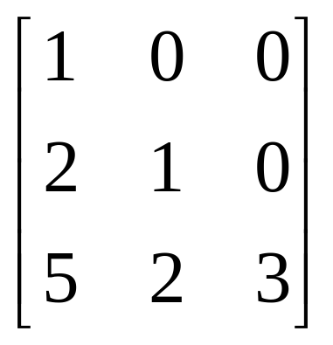
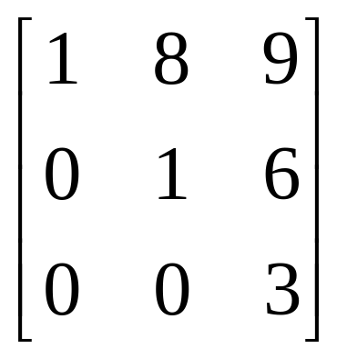
Matrices - Introduction
8. Triangular matrix
A square matrix whose elements above or below the main diagonal are all zero

Slide 14
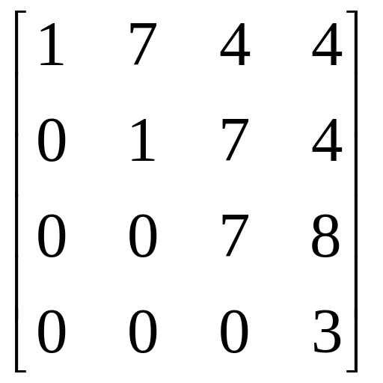
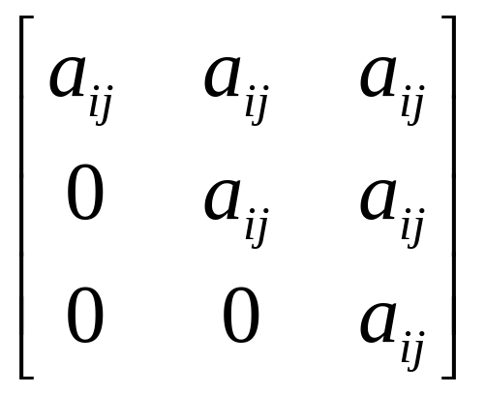
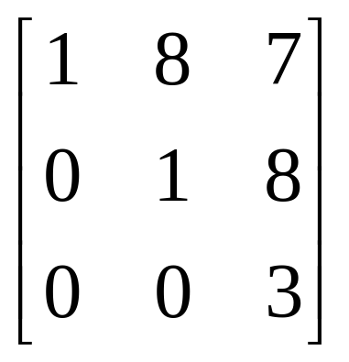
Matrices - Introduction
8a. Upper triangular matrix
A square matrix whose elements below the main diagonal are all zero.
i.e. a_{ij} = 0 for all i > j

Slide 15
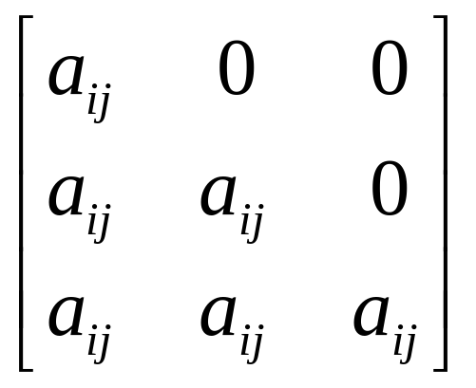
Matrices - Introduction
8b. Lower triangular matrix
A square matrix whose elements above the main diagonal are all zero
i.e. a_{ij} = 0 for all i < j

Slide 16
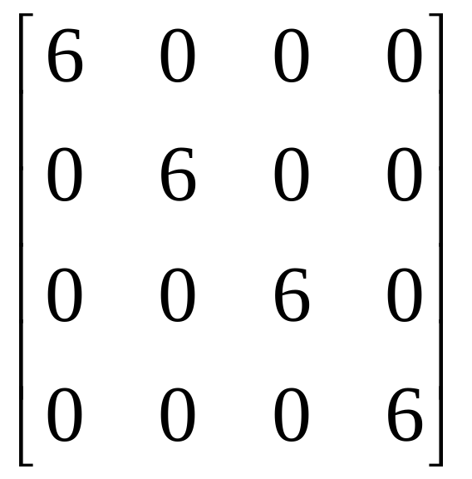
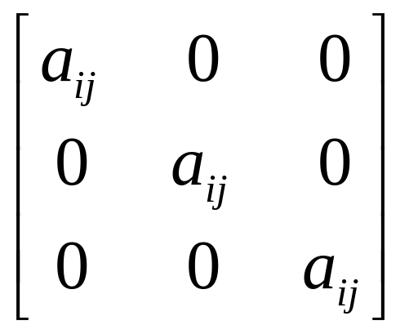
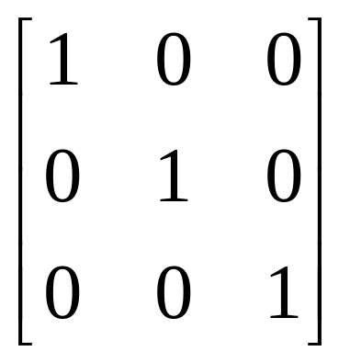
Matrices – Introduction
9. Scalar matrix
A diagonal matrix whose main diagonal elements are equal to the same scalar
A scalar is defined as a single number or constant
i.e. a_{ij} = 0 for all i = j
a_{ij} = a for all i = j

Slide 17
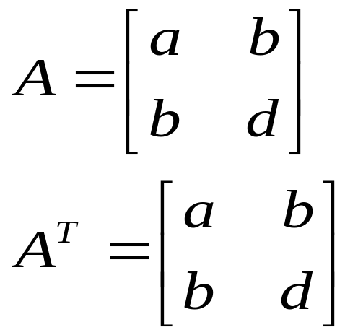
SYMMETRIC MATRICES
A Square matrix is symmetric if it is equal to its transpose:
A = A^{T}
Skew-SYMMETRIC MATRICES
A Square matrix is skew-symmetric if it is equal to its negative transpose:
A = -A^{T}

Slide 18
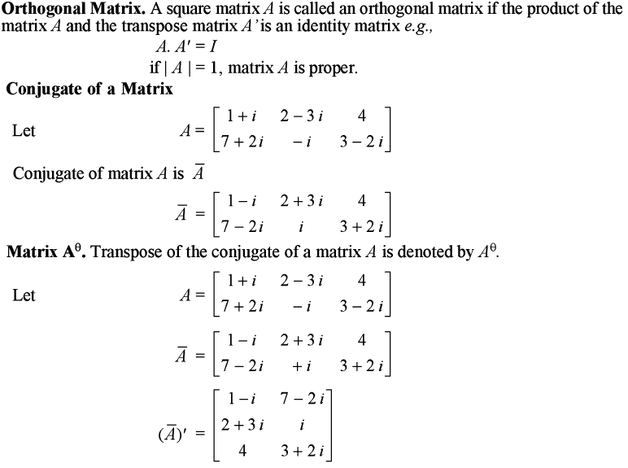

Slide 19
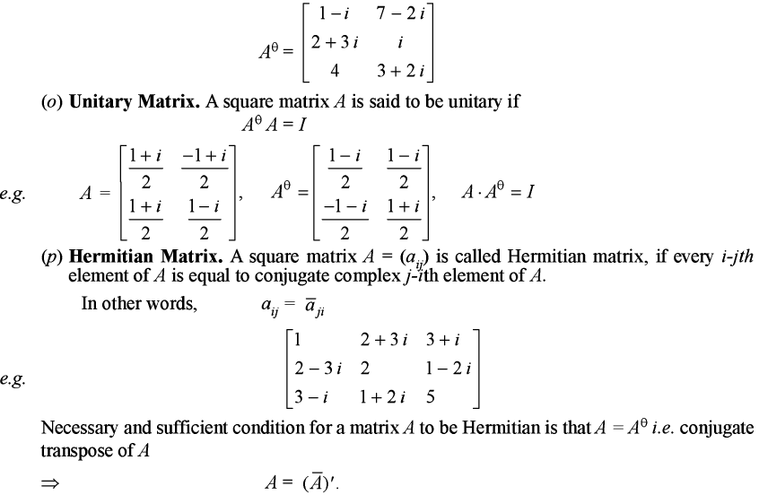

Slide 20

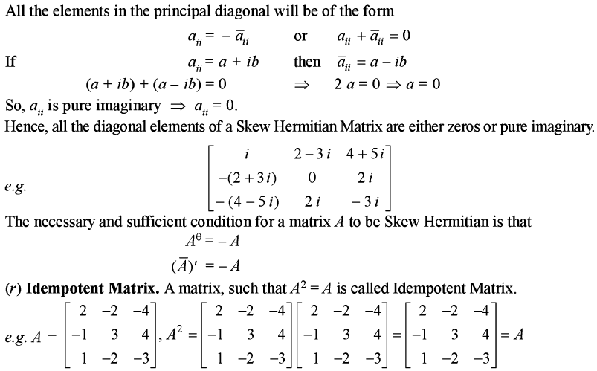

Slide 21
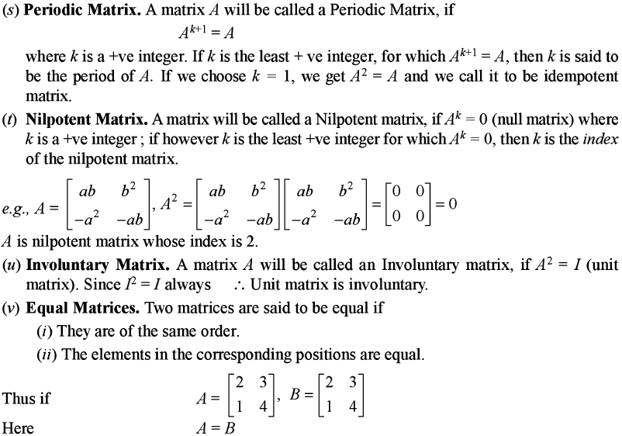

Slide 22
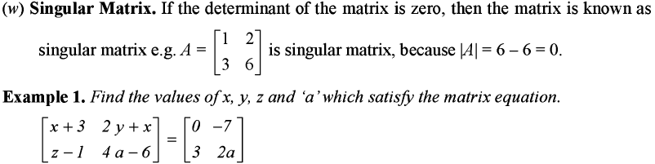
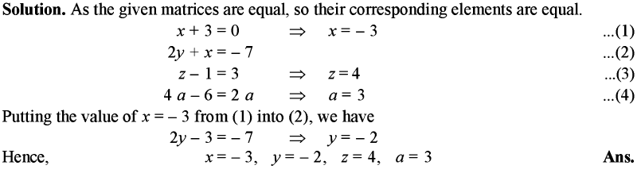

Slide 23
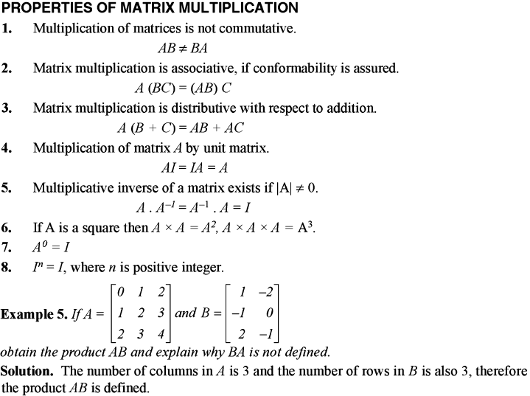

Slide 24
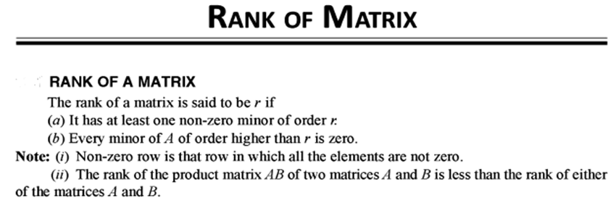
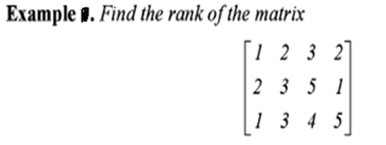

Slide 25
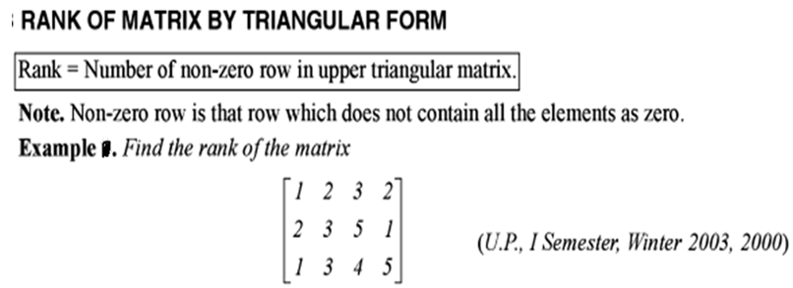

Slide 26
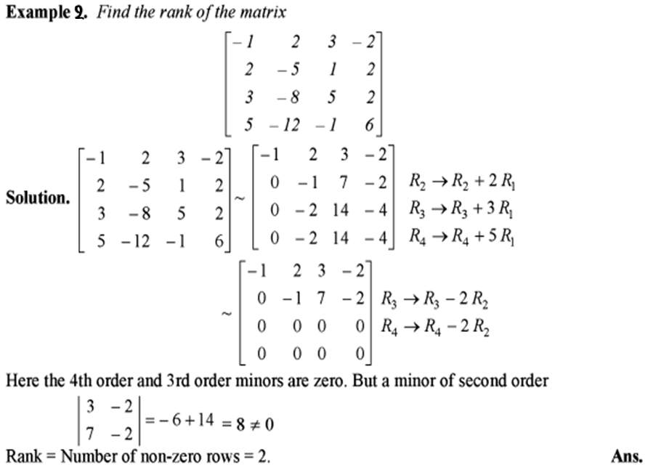

Slide 27
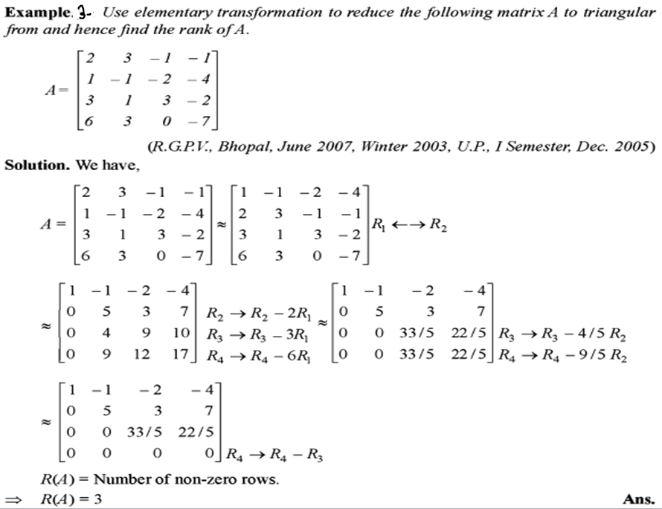

Slide 28
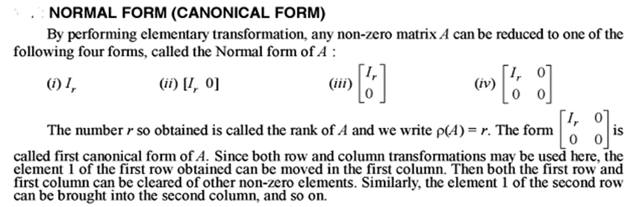

Slide 29
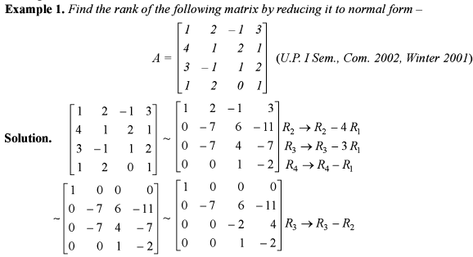
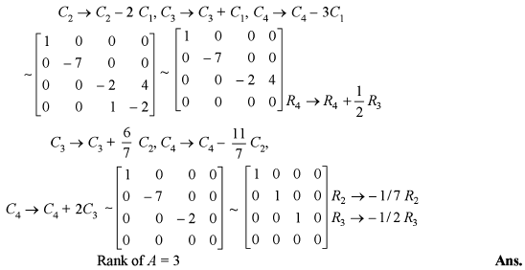

Slide 30


Slide 31



Slide 32


Slide 33


Slide 34


Slide 35


Slide 36



Slide 37


Slide 38


Slide 39


Slide 40


Slide 41



Slide 42


Slide 43


Slide 44



Slide 45


Slide 46


Slide 47


Slide 48



Slide 49


Slide 50


Slide 51



Slide 52


Slide 53


Slide 54


Slide 55


Slide 56


Slide 57


Slide 58


Slide 59



Slide 60


Slide 61


Slide 62


Slide 63


Slide 64


Slide 65



Slide 66



Slide 67


Slide 68



Slide 69


Slide 70


Slide 71



Slide 72


Slide 73
Thank You

